Slide 1




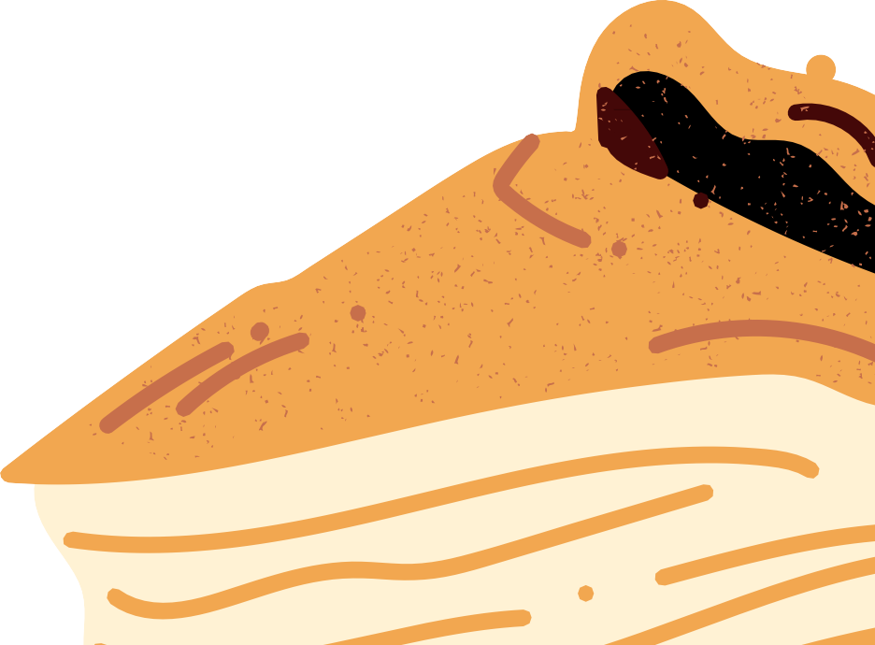
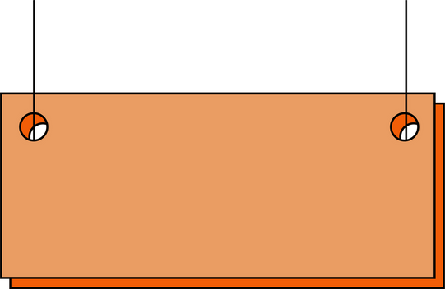

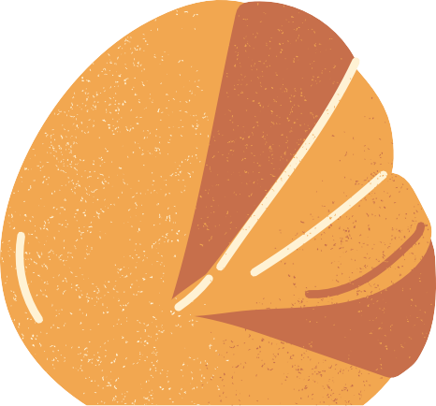
WARM LOAF
B. S. Abdur Rahman Crescent Institute of Science and Technology
MILESTONE 1

Slide 2

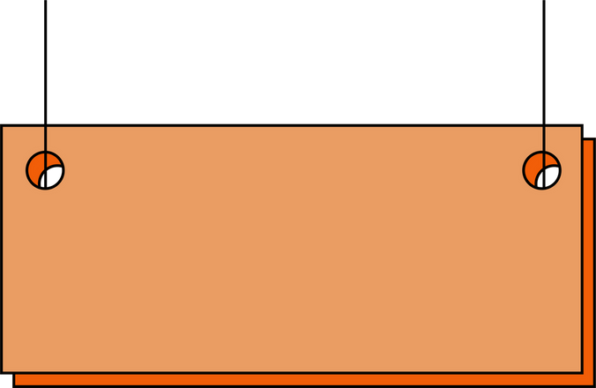


To bring joy and warmth into every home through handcrafted, high-quality baked goods made with love, fresh ingredients, and a personal touch. We aim to create memorable moments with every bite, delivering homemade goodness that feels like home."
MISSION
"To be a beloved home baking brand known for its commitment to quality, creativity, and customer satisfaction. We envision a world where our baked treats bring people together, spread happiness, and inspire a passion for homemade delights."
VISSION

Slide 3

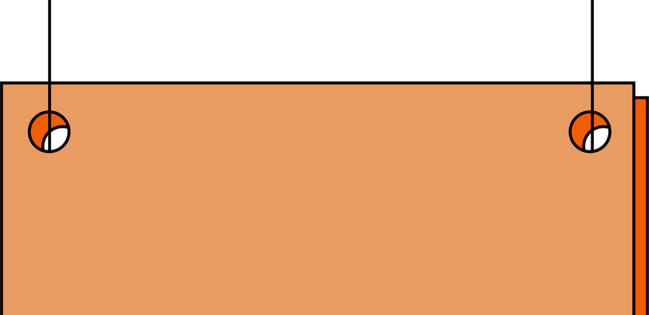


WHY
WHO ARE WE?
HOW
Using only the finest and freshest ingredients.
Paying attention to detail and presentation.
Ensuring every order is made with love, passion, and dedication.
To spread happiness through delicious homemade
baked goods.
To create memorable moments for families, friends,
and special occasions.
To share the love of baking and the warmth
of homemade treats.
WHAT
Bake fresh, handcrafted cakes, cookies, pastries, and other treats.
Offer customized baked goods for birthdays, weddings, and celebrations.
Provide high-quality, preservative-free, and delightful homemade flavors.

Slide 4





Problems/ Opportunity
WHEN DOES THE PROBLEM ARISE?
The problem arises when customers struggle to find fresh, high-quality, and homemade-style baked goods that cater to their preferences. Many commercial bakery products lack the warmth, taste, and personal touch that people seek, especially for special occasions
WHAT ARE THE ROOT CAUSES OF PROBLEM?
The root causes of this issue stem from mass production in commercial bakeries, which often prioritizes efficiency over quality.
Store-bought baked goods usually contain preservatives to extend shelf life, compromising freshness and taste. or personalized treats

Slide 5
Problems/ Opportunity
WHAT ALTERNATIVES DO CUSTOMERS USE TO FIX THE PROBLEM?
To address this issue, customers typically turn to supermarket bakeries, which provide convenience but often at the cost of quality. Some opt for large- scale online bakeries that offer more variety but lack the homemade feel and customization.
WHO FACES THESE KIND OF PROBLEMS MOST OFTEN?
The people most affected by this problem include individuals looking for high-quality, homemade-style baked goods for themselves or their loved ones.
Event planners and customers celebrating birthdays, weddings, and anniversaries often struggle

Slide 6


PROBLEM STATEMENT
Prevalence of Low-Quality or Harmful Materials
Mass-produced baked goods often contain artificial preservatives, trans fats, and excessive sugar, leading to health risks
The baking industry contributes to pollution through excessive plastic
packaging, ingredient sourcing issues, and food waste.
Growing Demand for Healthier and Sustainable Options
Environmental Concerns
Consumers now prefer baked goods made with natural, organic, and
plant-based ingredients.
Challenges of Transition
Switching to sustainable and healthier baking is costly and requires careful
ingredient sourcing, recipe adjustments, and eco-friendly packaging solutions.

Slide 7



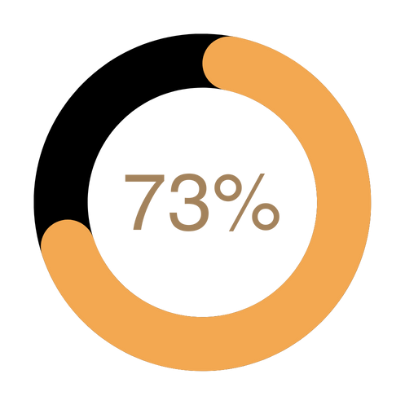


CUSTOMER REVIEW AND SURVEYS
DETAILS OF THE SURVEY
CUSTOMER INTERVIEWED
People who agree that this is a problem and can be solved
People who suggest that they had already solved the problem
RESULTS
93
73%
27%

Slide 8
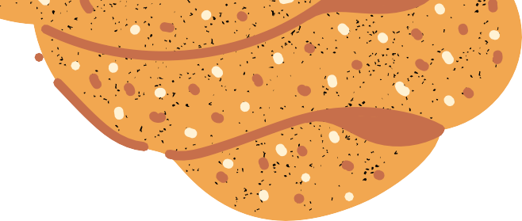
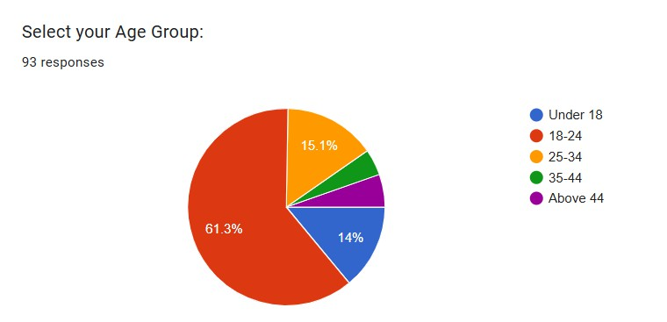
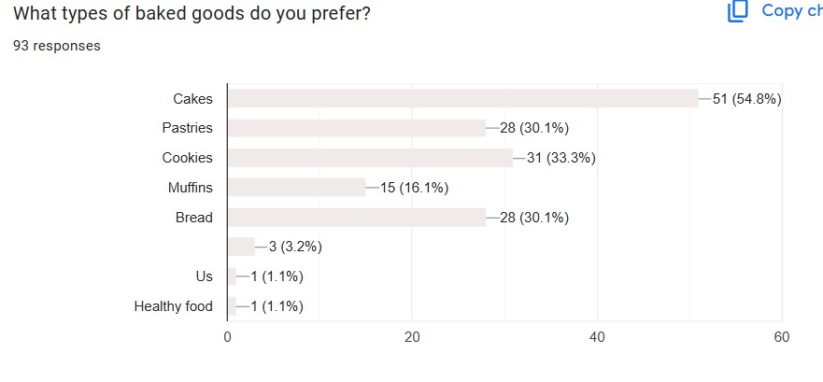
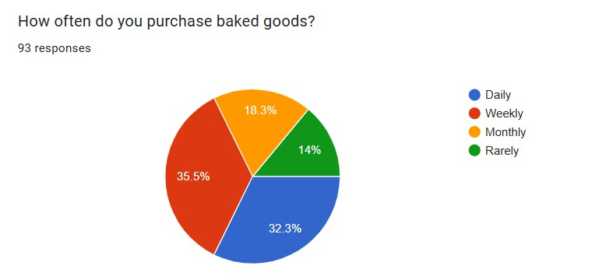

Slide 9

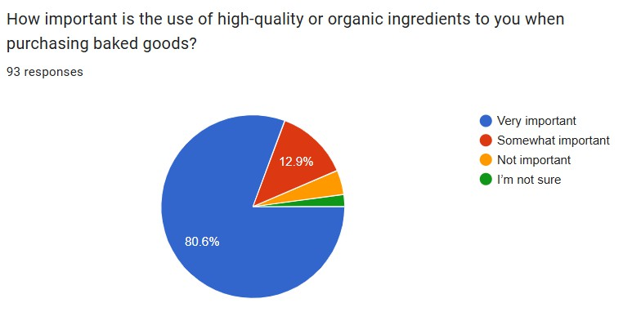
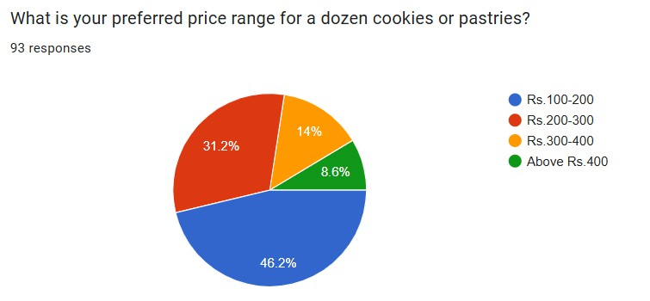
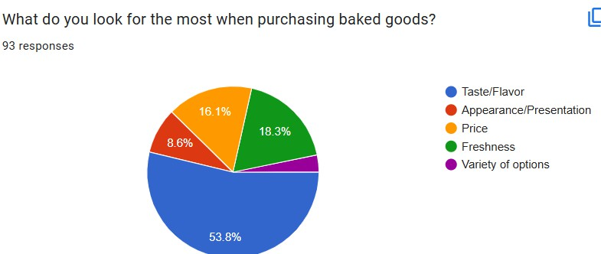

Slide 10
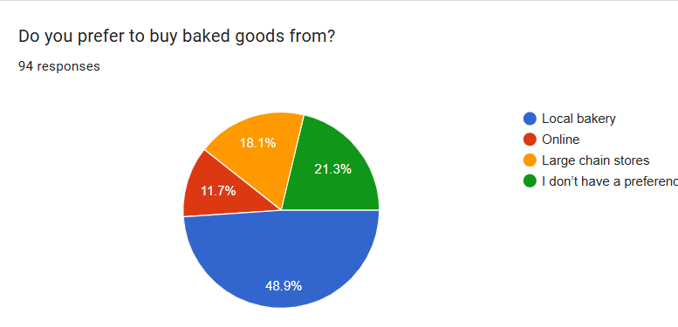
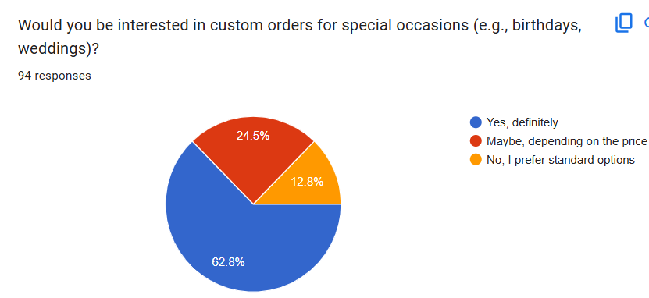
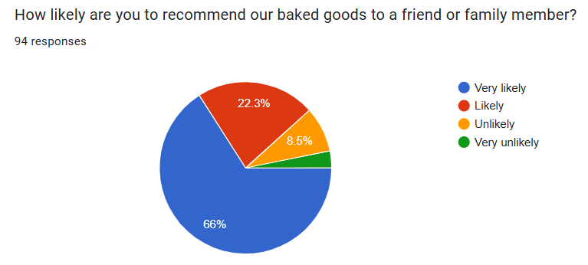

Slide 11
SURVEY RESULTS
Organic & Natural Ingredients – Products made without artificial preservatives, colors, or additives.
Low-Sugar & Gluten-Free Options – Health- conscious consumers seek alternatives with natural sweeteners and gluten-free flour
Which Products Are Customers Willing to Use?
Packaging Preference
Biodegradable & Compostable
Materials – Paper-based or plant-fiber packaging over plastic.
Minimalist & Recyclable Packaging –
Simple, waste-free wrapping that maintains freshness.

Slide 12



MARKET SIZE ESTIMATION
SAM
TAM
If your bakery operates in a specific city with a
$500 million bakery industry,
and you target a niche (e.g., artisanal, gluten- free, or home-style baking),
SOM
The global bakery market is estimated at $500+ billion annually.
If your bakery can realistically capture 1% of your SAM
based on competition, capacity, and marketing reach,
your SOM would be $500,000 annually.
If you focus on a specific country, say the U.S. bakery market,
it is valued at around $100 billion annually.

Slide 13



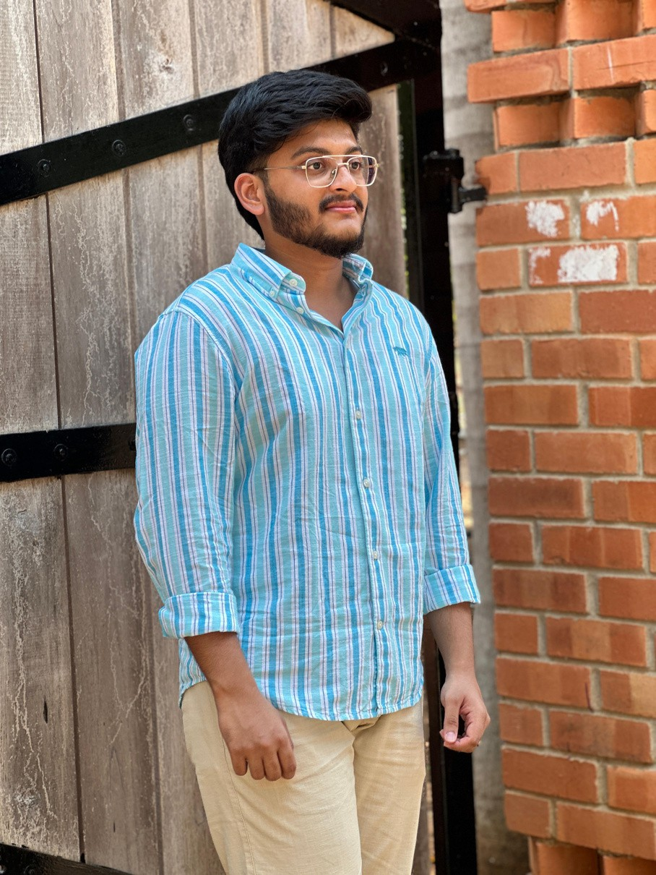
OUR TEAM
GOWTHAM(220071601076
FAZIL IBRAHIM(220071601070) - CMO
HAAMID(220071601078) - CEO
COO

Slide 14
THANK YOU

